Slide 1
Polish Currency
Polish złoty

Slide 2
The złoty (pronounced [ˈzwɔtɨ]] sign: zł; code: PLN), which literally means "golden", is the currency of Poland. The modern złoty is subdivided into 100 groszy (singular: grosz, alternative plural forms: grosze; groszy). The recognized English form of the word is zloty, plural zloty or zlotys.

Slide 3
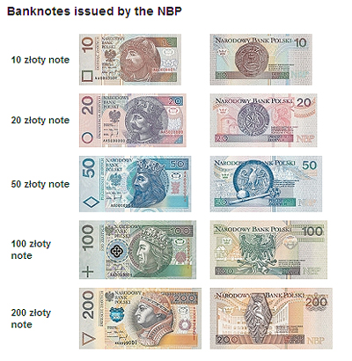
BANKNOTES

Slide 4
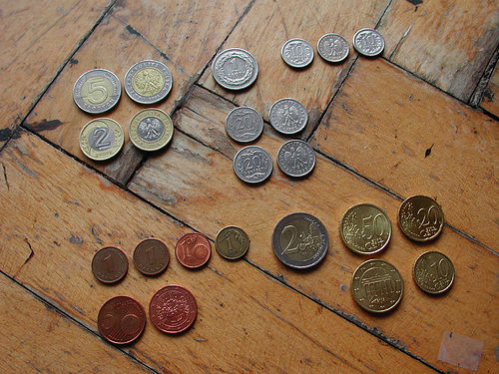
COINS

Slide 5
Cost of Living in Poland
Eating out and buying groceries is generally cheaper than in Western European cities, but purchasing imported articles will be significantly more expensive, and in some cases, priced even higher than in places like Paris and London.
The price of a good meal out with a glass of wine costs between 70 and 100 PLN, and a kebab will cost a mere 8 PLN. Weekly shopping for a single individual would be roughly 200 PLN.
Petrol prices in Poland are on par with the rest of Europe, while public transportation tickets are still relatively inexpensive. Furthermore, students, pupils and senior citizens are eligible for 50 percent discounts on long-term ticketing.

Slide 6
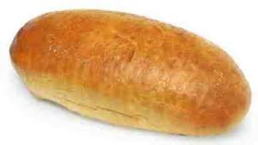
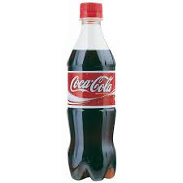
1 € = 4, 20 zł
2,80 zł
3 zł
3.50 zł
9 zł

