Slide 1
Short impression of the Comeniusweek The Netherlands
March 2015
C.P. van Leersumschool

Slide 2
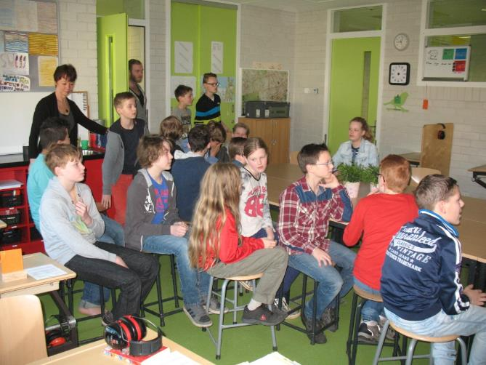
Students meeting, presentation about Austria.

Slide 3
Excursion with the students to a glass workshop in Doorn

Slide 4
Instructions by the artist.

Slide 5
Students and their products in glass workshop Doorn

Slide 6
The students traveling by bus to Utrecht to join the group visiting the museum

Slide 7
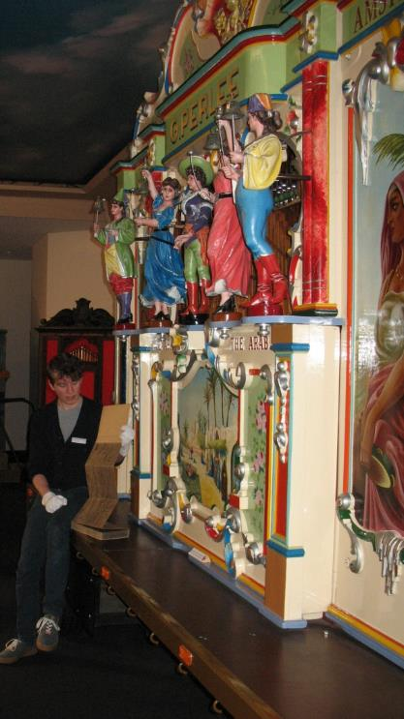
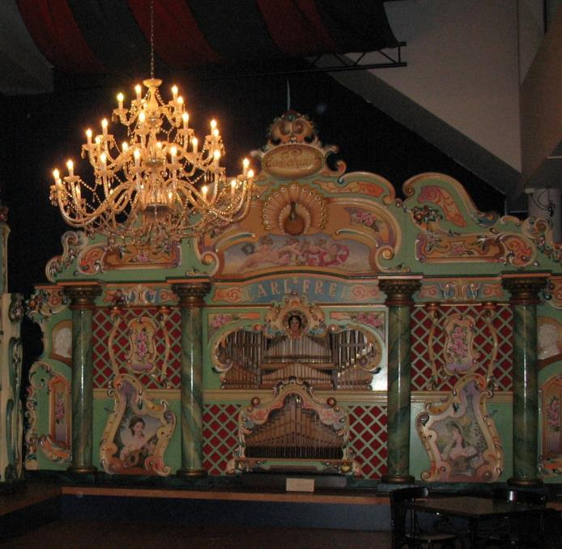
Museum: Van speelklok tot pierement

Slide 8
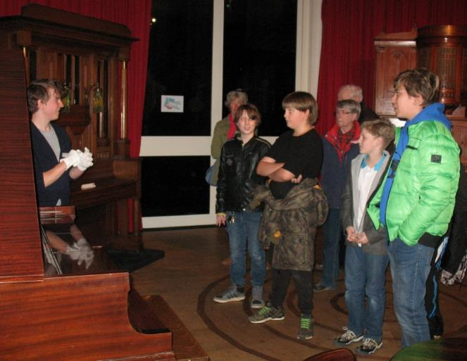

Slide 9
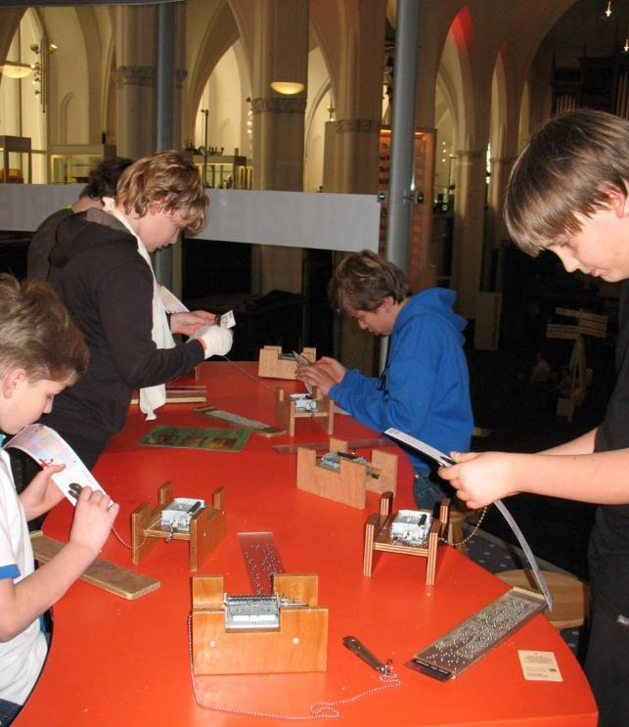
Try it yourself

Slide 10
Utrecht: starting point of the Tour de France 2015

Slide 11
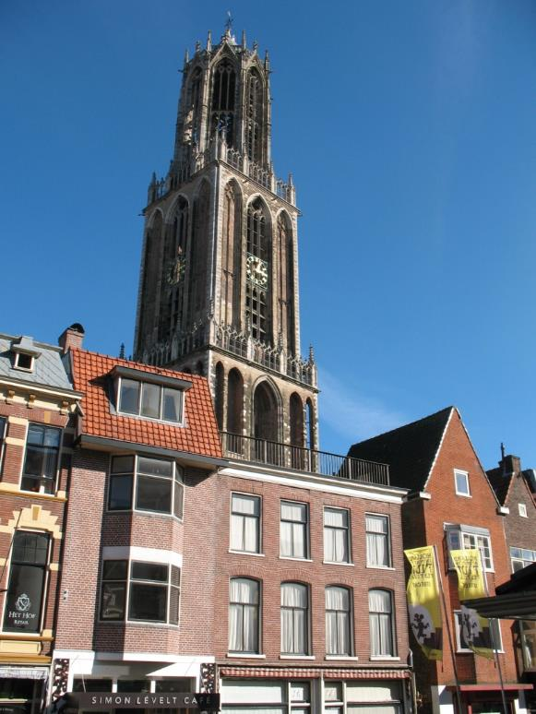
Walking through the historcal centre off Utrecht

Slide 12
Greeting the statue of Anne Frank in Utrecht

Slide 13
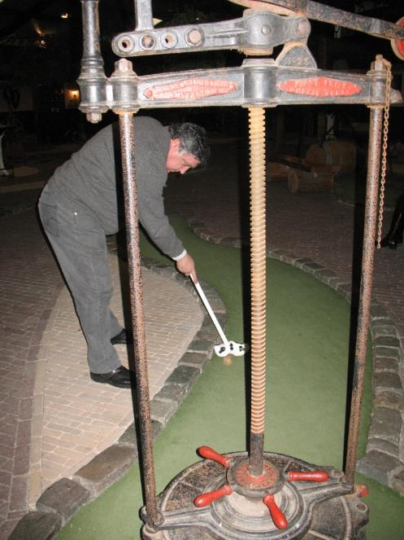
In the evening playing Dutch Farmers golf

Slide 14
Pancakes and gourmet

Slide 15
Visit with the sudents to the windmill in Amerongen

Slide 16
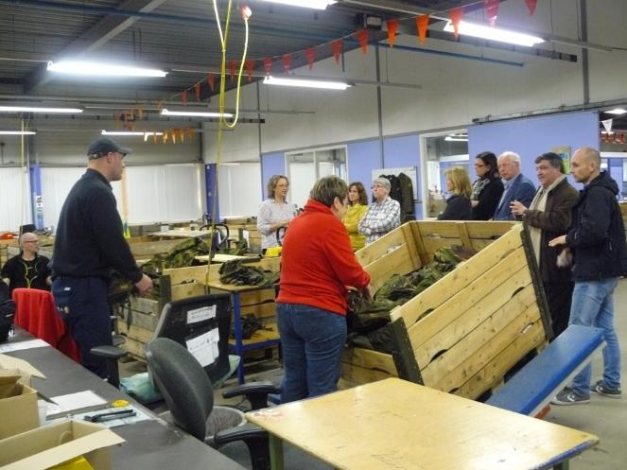
Visiting BIGA workforce Zeist

