Slide 1
THE CLASSIC DANISH RICE PUDDING

Slide 2
Rice pudding with cinnamon sugar and butter

Slide 3
3 deciliter water 180 g pudding rice 1 liter low fat milk ¼ teaspoon salt Cinnamonsugar: 4 tablespoon sugar 2 teaspoon grounded cinnamon Butter (Topping)
INGREDIENTS:

Slide 4
Bring water and rice to a boil in a saucepan . Cook the rice over a moderate heat and stir for about 2 min . Add milk and bring the mixture to a boil . Cook the rice over low heat , still stirring , for about 10 min . Cover and cook about 25 min . Stir often. If the porridge seems thin then boil it for approximately 5 min . - Without lid . Add salt and season to taste. ----------------------------------------------------------------------- Mix sugar and cinnamon in a bowl
DIRECTIONS:

Slide 5
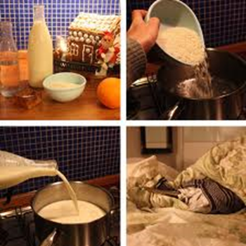

Slide 6
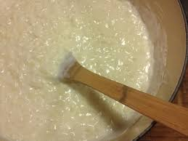

Slide 7
Put the rice pudding in a bowl . Sprinkle the porridge with cinnamon sugar and a knob of butter.
SERVING:

Slide 8
